Slide 1
ADVANCED PROCESSORS & CONTROLLERS
Module 6

Slide 2
Contents
Advanced Microprocessor Architecture- Pentium
Concept of CISC and RISC processors
Introduction to ARM processor and PIC micro controller

Slide 4
Pentium Family
Intel introduced microprocessors in 1969
4-bit microprocessor 4004
8-bit microprocessors
8080
8085
16-bit processors
8086 introduced in 1979
20-bit address bus, 16-bit data bus
8088 is a less expensive version
Uses 8-bit data bus
Can address up to 4 segments of 64 KB
Referred to as the real mode
80186
A faster version of 8086
16-bit data bus and 20-bit address bus
Improved instruction set
80286 was introduced in 1982
24-bit address bus
16 MB address space
Enhanced with memory protection capabilities
Introduced protected mode
Segmentation in protected mode is different from the real mode
Backwards compatible

Slide 5
Pentium Family
80386 was introduced 1985
First 32-bit processor
32-bit data bus and 32-bit address bus
4 GB address space
Segmentation can be turned off (flat model)
Introduced paging
80486 was introduced 1989
Improved version of 386
Combined coprocessor functions for performing floating-point arithmetic
Added parallel execution capability to instruction decode and execution units
Achieves scalar execution of 1 instruction/clock
Later versions introduced energy savings for laptops
Pentium (80586) was introduced in 1993
Similar to 486 but with 64-bit data bus
Wider internal data paths
128- and 256-bit wide
Added second execution pipeline
Superscalar performance
Two instructions/clock
Doubled on-chip L1 cache
8 KB data
8 KB instruction
Added branch prediction

Slide 6
Pentium Family
Pentium Pro was introduced in 1995
Three-way superscalar
3 instructions/clock
36-bit address bus
64 GB address space
Introduced dynamic execution
Out-of-order execution
Speculative execution
In addition to the L1 cache
Has 256 KB L2 cache
Pentium II was introduced in 1997
Introduced multimedia (MMX) instructions
Doubled on-chip L1 cache
16 KB data
16 KB instruction
Introduced comprehensive power management features
Sleep
Deep sleep
In addition to the L1 cache
Has 256 KB L2 cache
Pentium III, Pentium IV,…
For more information visit https://en.wikipedia.org/wiki/List_of_Intel_microprocessors

Slide 7
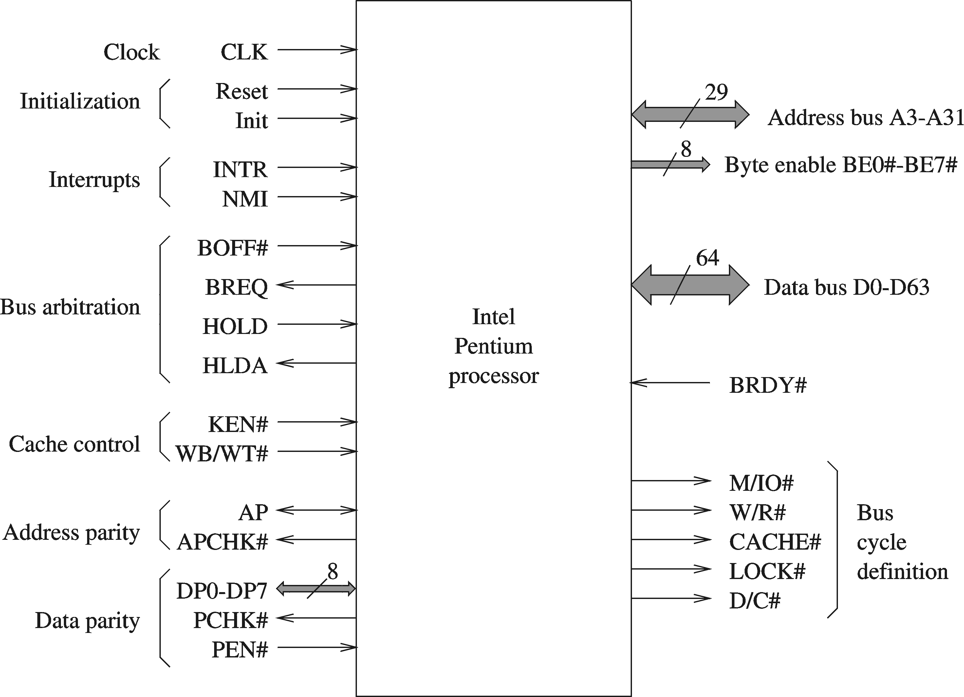
Pentium Processor

Slide 8
Pentium Processor
Data bus (D0 – D 63)
64-bit data bus
Address bus (A3 – A31)
Only 29 lines
No A0-A2 (due to 8-byte wide data bus)
Byte enable (BE0# - BE7#)
Identifies the set of bytes to read or write
BE0# : least significant byte (D0 – D7)
BE1# : next byte (D8 – D15)
…
BE7# : most significant byte (D56 – D63)
Any combination of bytes can be specified
Data parity (DP0 – DP7)
Even parity for 8 bytes of data
DP0 : D0 – D7
DP1 : D8 – D15
…
DP7 : D56 – D63
Parity check (PCHK#)
Indicates the parity check result on data read
Parity is checked only for valid bytes
Indicated by BE# signals

Slide 9
Pentium Processor
Cacheability (CACHE#)
Read cycle: indicates internal cacheability
Write cycle: burst write-back
Bus lock (LOCK#)
Used in read-modify-write cycle
Useful in implementing semaphores
Interrupt (INTR)
External interrupt signal
Nonmaskable interrupt (NMI)
External NMI signal
Parity enable (PEN#)
Determines whether parity check should be used
Address parity (AP)
Bad address parity during inquire cycles
Memory/IO (M/IO#)
Defines bus cycle: memory or I/O
Write/Read (W/R#)
Distinguishes between write and read cycles
Data/Code (D/C#)
Distinguishes between data and code

Slide 10
Pentium Processor
Clock (CLK)
System clock signal
Bus ready (BRDY#)
Used to extend the bus cycle
Introduces wait states
Bus request (BREQ)
Used in bus arbitration
Backoff (BOFF#)
Aborts all pending bus cycles and floats the bus
Useful to resolve deadlock between two bus masters
Bus hold (HOLD)
Completes outstanding bus cycles and floats bus
Asserts HLDA to give control of bus to another master
Bus hold acknowledge (HLDA)
Indicates the Pentium has given control to another local master
Pentium continues execution from its internal caches
Cache enable (KEN#)
If asserted, the current cycle is transformed into cache line fill

Slide 11
Pentium Processor
Write-back/Write-through (WB/WT#)
Determines the cache write policy to be used
Reset (RESET)
Resets the processor
Starts execution at FFFFFFF0H
Invalidates all internal caches
Initialization (INIT)
Similar to RESET but internal caches and FP registers are not flushed
After powerup, use RESET (not INIT)
Notes:
a semaphore is a variable or abstract data type that is used for controlling access, by multiple processes, to a common resource in a concurrent system such as a multiprogramming operating system.

Slide 12
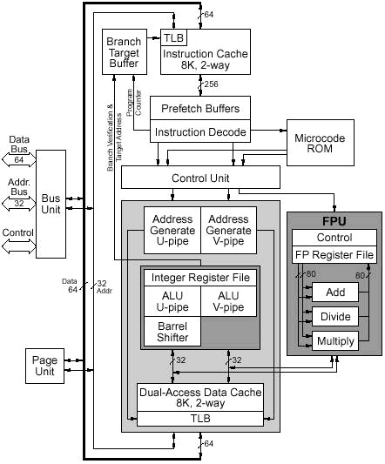
Pentium Architecture
Notes:
A translation lookaside buffer (TLB) is a memory cache that stores recent translations of virtual memory to physical addresses for faster retrieval.

Slide 13
Features
Superscalar Execution
the Pentium processor can sometimes execute two instructions simultaneously.
Pipeline Architecture:
the Pentium processor executes instructions in five stages.
This staging, or pipelining, allows the processor to overlap multiple instructions so that it takes less time to execute two instructions in a row.
Because of its superscalar architecture, the Pentium processor has two independent processor pipelines.

Slide 14
Pipeline concept
Pre fetch Instruction
Decode Instruction and generate control word
Generate control word and data memory address
Generate control word and data memory address
Address data cache
Calculate ALU result
Address data cache
Calculate ALU result
Write back results
Write back results
U pipe
V pipe

Slide 15
Features
Branch Target Buffer:
It fetches the branch target instruction before it executes the branch instruction.
Dual 8-KB On-Chip Caches:
Has two separate 8-kilobyte (KB) caches on chip
one for instructions and
one for data
--which allows the Pentium processor to fetch data and instructions from the cache simultaneously.
Write-Back Cache:
When data is modified; only the data in the cache is changed.
Memory data is changed only when the Pentium processor replaces the modified data in the cache with a different set of data

Slide 16
Features
64-Bit Bus
Can handle up to twice the data load of the Intel486 processor at the same clock frequency.
Instruction Optimization:
Has been optimized to run critical instructions in fewer clock cycles than the Intel486 processor.
Floating-Point Optimization:
Executes individual instructions faster through execution pipelining, which allows multiple floating-point instructions to be executed at the same time.

Slide 17
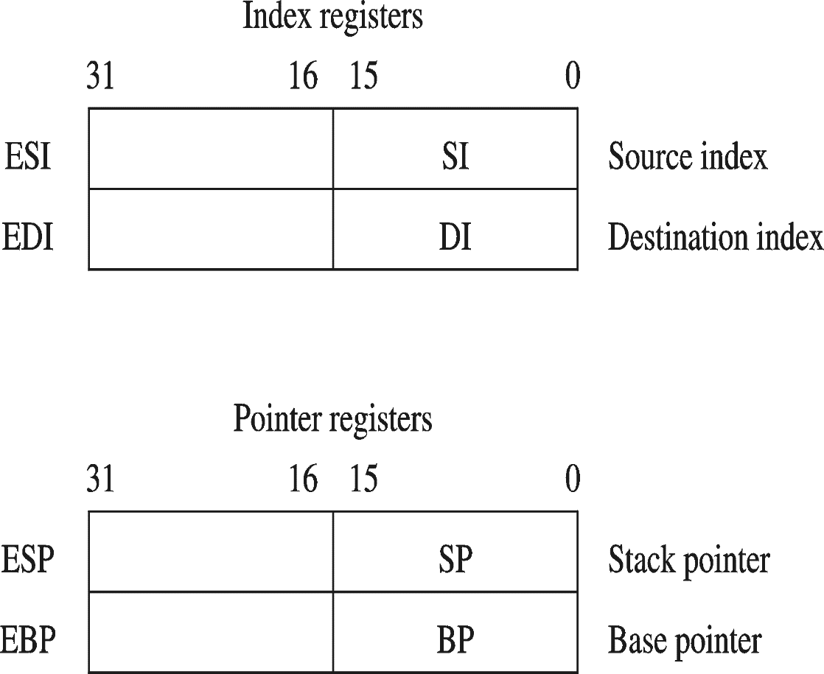
Pentium Registers

Slide 18
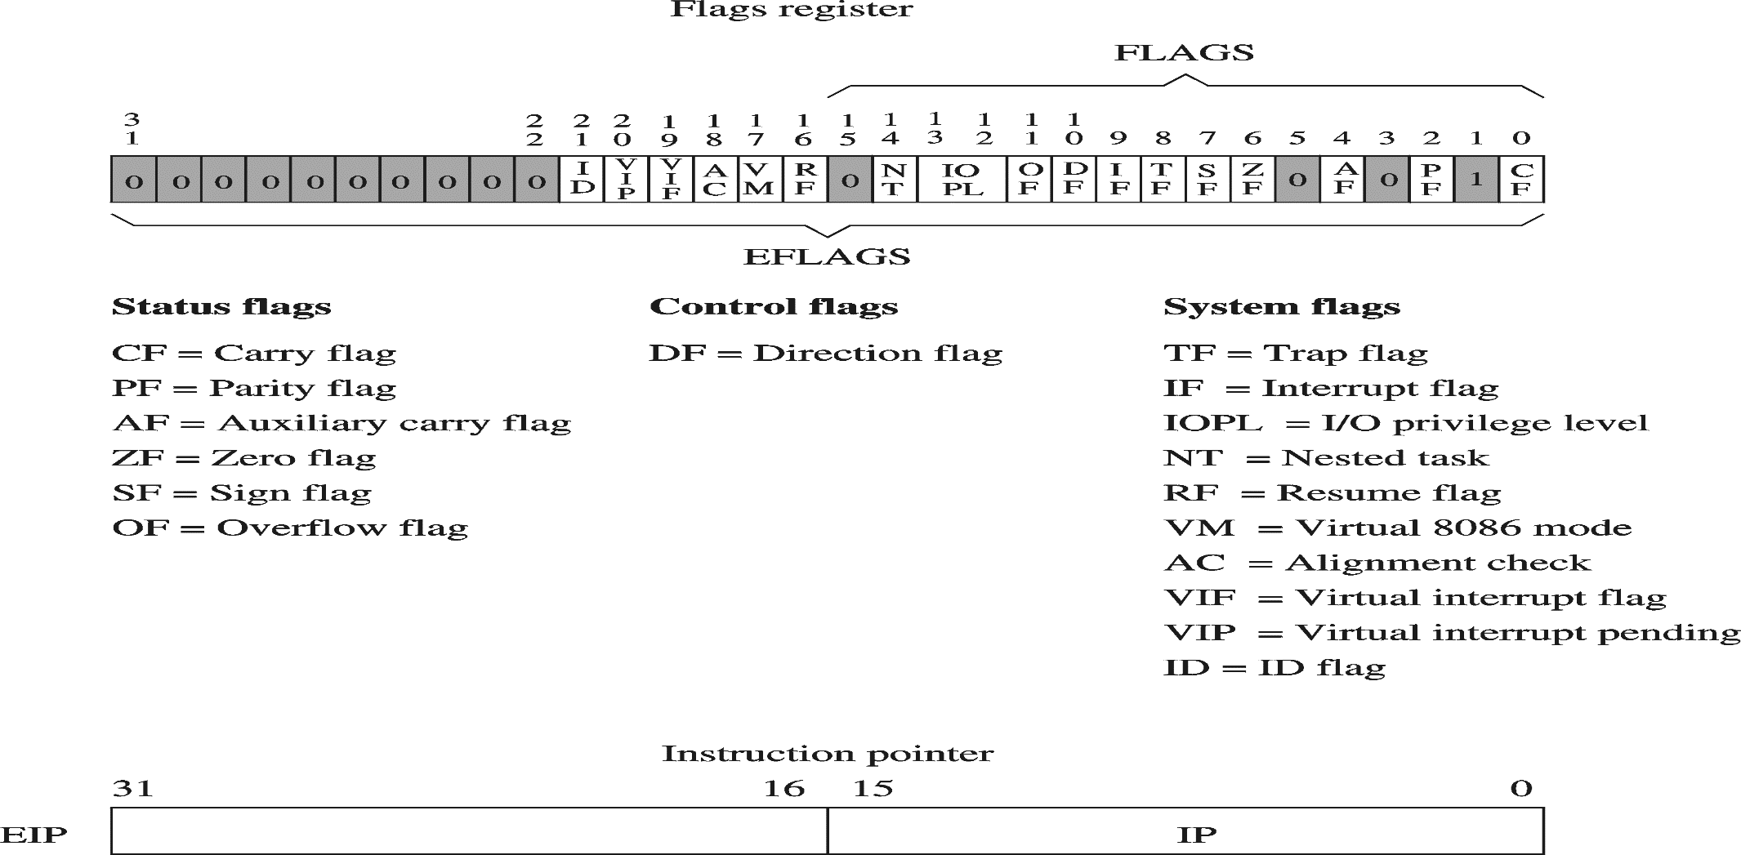
Flag Register

Slide 19
Pentium Registers
Control registers
(E)IP
Program counter
(E) FLAGS
Status flags
Record status information about the result of the last arithmetic/logical instruction
Direction flag
Forward/backward direction for data copy
System flags
IF : interrupt enable
TF : Trap flag (useful in single-stepping)

Slide 20
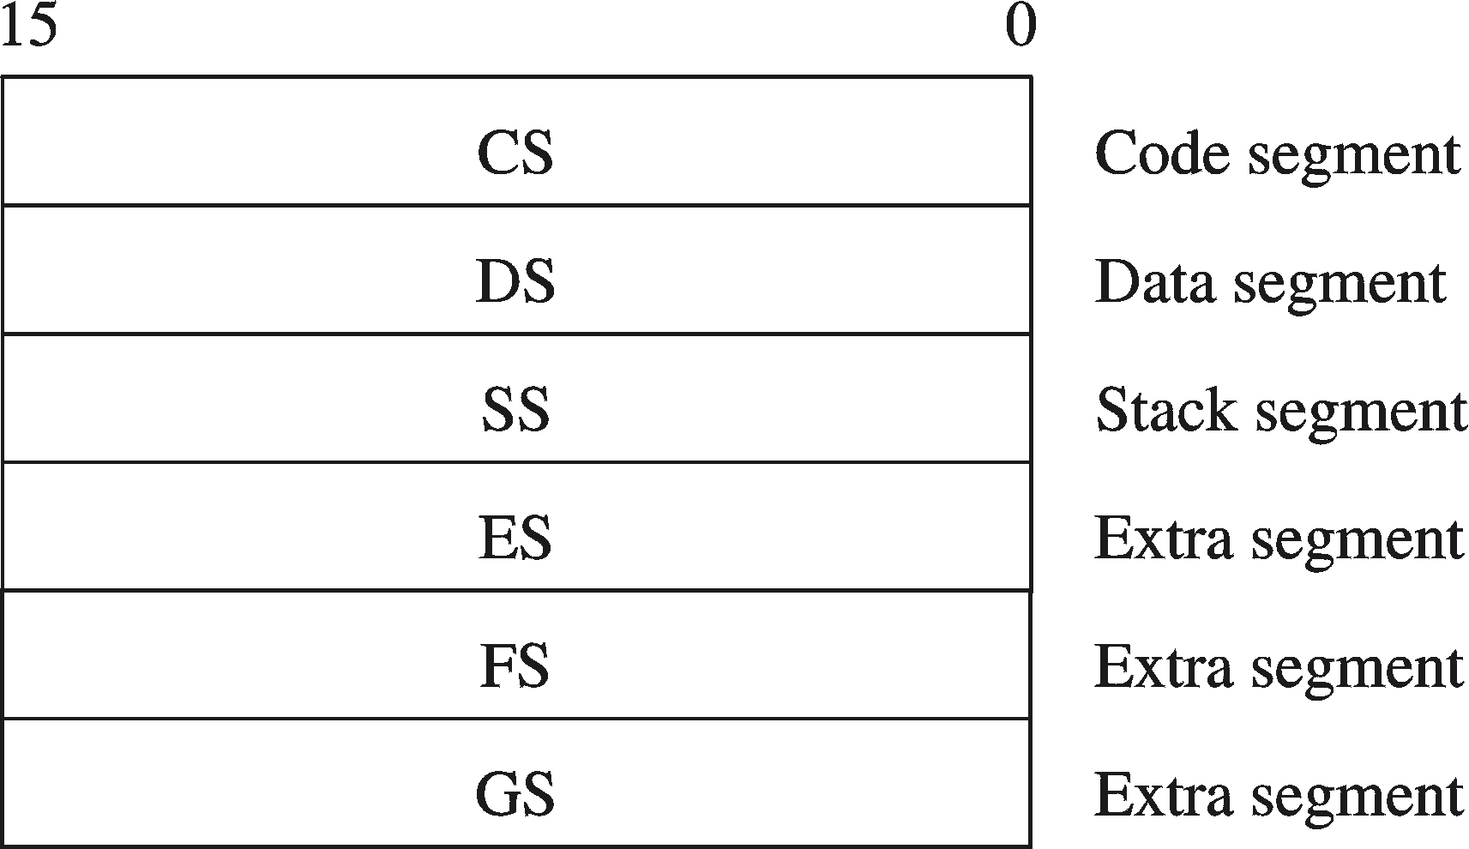
Pentium Registers
Segment register
Six 16-bit registers
Support segmented memory architecture
At any time, only six segments are accessible
Segments contain distinct contents
Code
Data
Stack
Extra

Slide 21
Real Mode Architecture
Pentium supports two modes
Real mode
Uses 16-bit addresses
Runs 8086 programs
Pentium acts as a faster 8086
Protected mode
32-bit mode
Native mode of Pentium
Supports segmentation and paging

Slide 22
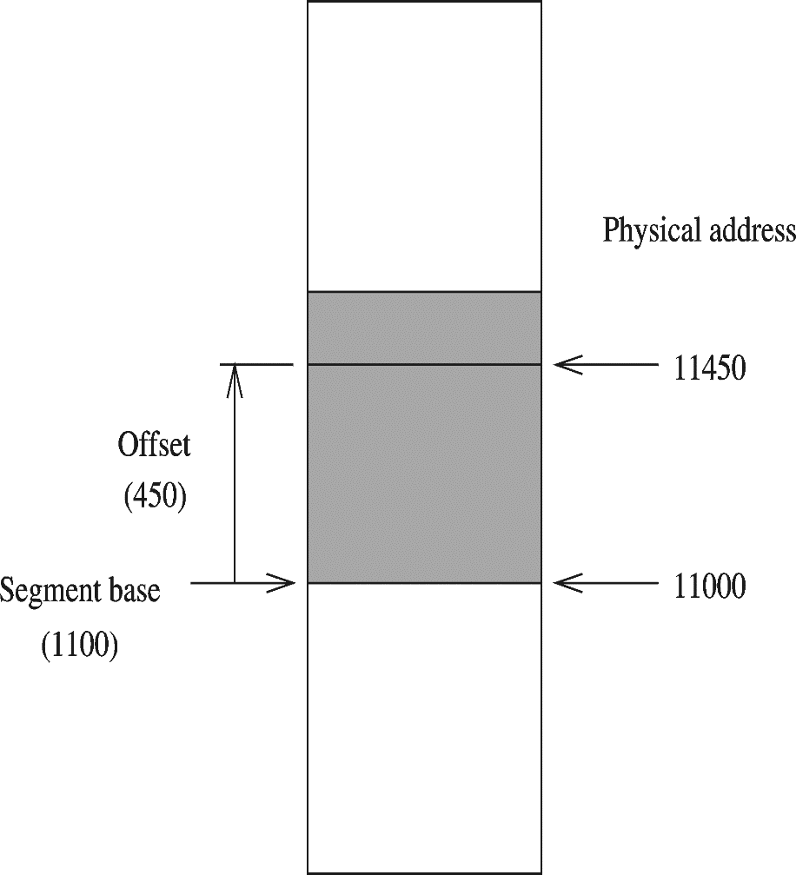
Real Mode Architecture (cont’d)
Segmented organization
16-bit wide segments
Two components
Base (16 bits)
Offset (16 bits)
Two-component specification is called logical address
Also called effective address
20-bit physical address

Slide 23
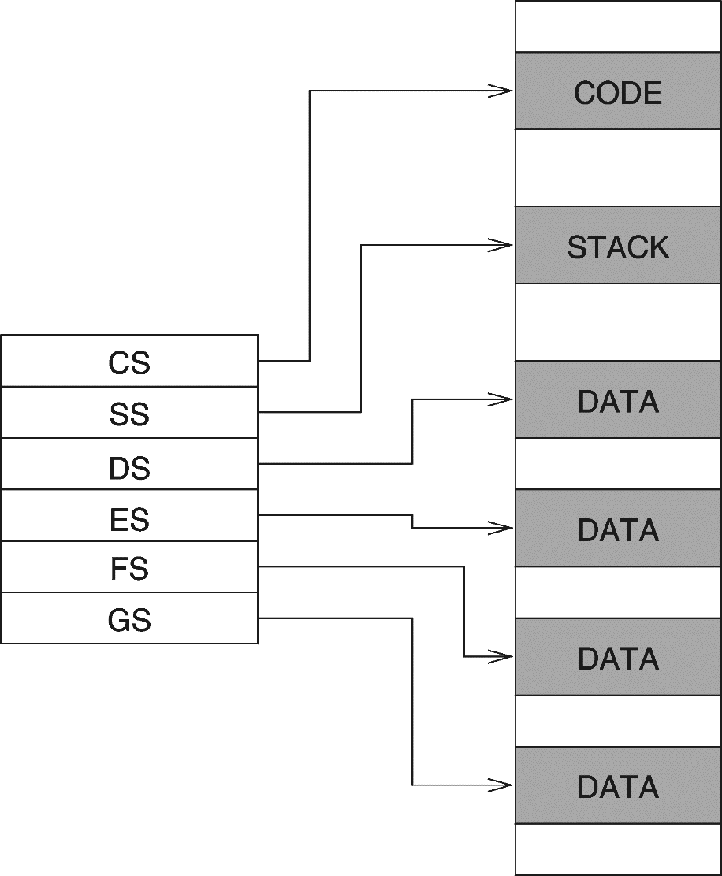
Real Mode Architecture (cont’d)
Programs can access up to six segments at any time
Two of these are for
Data
Code
Another segment is typically used for
Stack
Other segments can be used for
data, code,..

Slide 24
Protected Mode Architecture
Supports sophisticated segmentation
Segment unit translates 32-bit logical address to 32-bit linear address
Paging unit translates 32-bit linear address to 32-bit physical address
If no paging is used
Linear address = physical address

Slide 25
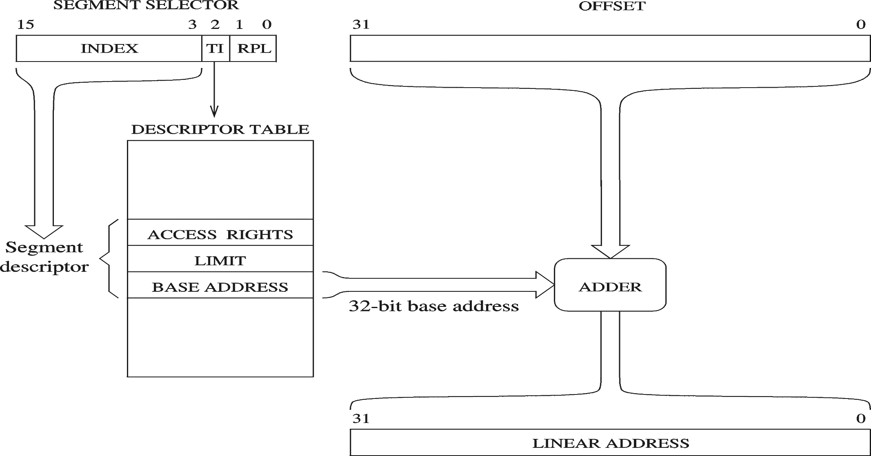
Protected Mode Architecture (cont’d)
Address translation

Slide 26
Protected Mode Architecture (cont’d)
Index
Selects a descriptor from one of two descriptor tables
Local
Global
Table Indicator (TI)
Select the descriptor table to be used
0 = Local descriptor table
1 = Global descriptor table
Requestor Privilege Level (RPL)
Privilege level to provide protected access to data
Smaller the RPL, higher the privilege level

Slide 27
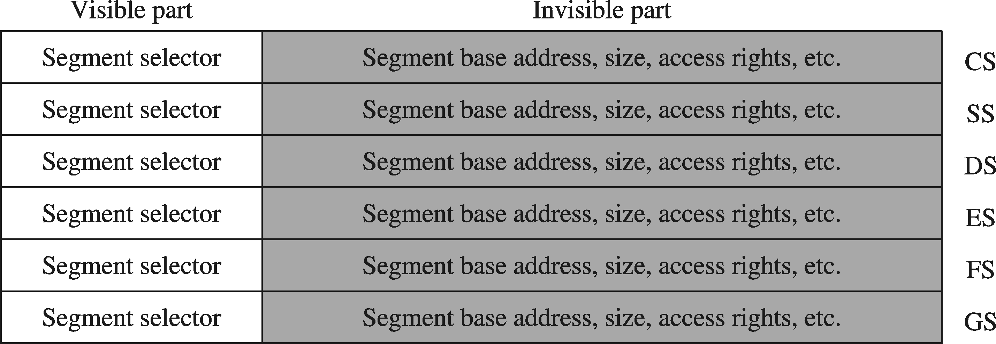
Protected Mode Architecture (cont’d)
Visible part
Instructions to load segment selector
mov, pop, lds, les, lss, lgs, lfs
Invisible
Automatically loaded when the visible part is loaded from a descriptor table

Slide 28
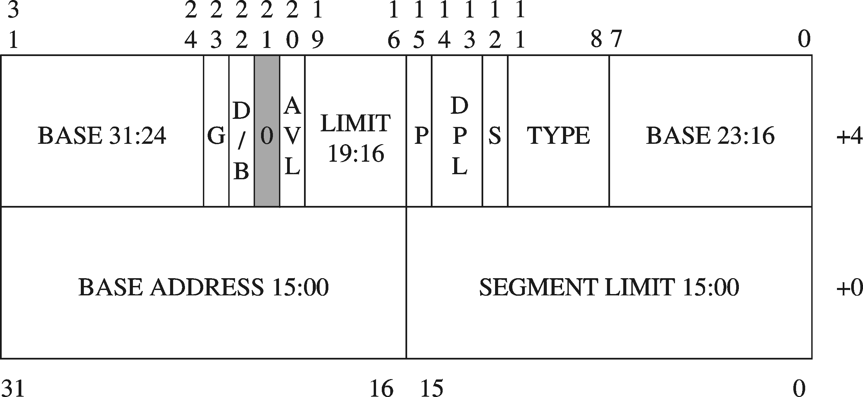
Protected Mode Architecture (cont’d)
Segment descriptor

Slide 29
Protected Mode Architecture (cont’d)
Base address
32-bit segment starting address
Granularity (G)
Indicates whether the segment size is in
0 = bytes, or
1 = 4KB
Segment Limit
20-bit value specifies the segment size
G = 0: 1byte to 1 MB
G = 1: 4KB to 4GB, in increments of 4KB
D/B bit
Code segment
D bit: default size operands and offset value
D = 0: 16-bit values
D = 1: 32-bit values
Data segment
B bit: controls the size of the stack and stack pointer
B = 0: SP is used with an upper bound of FFFFH
B = 1: ESP is used with an upper bound of FFFFFFFFH
Cleared for real mode
Set for protected mode

Slide 30
Protected Mode Architecture (cont’d)
S bit
Identifies whether
System segment, or
Application segment
Descriptor privilege level (DPL)
Defines segment privilege level
Type
Identifies type of segment
Data segment: read-only, read-write, …
Code segment: execute-only, execute/read-only, …
P bit
Indicates whether the segment is present
Three types of segment descriptor tables
Global descriptor table (GDT)
Only one in the system
Contains OS code and data
Available to all tasks
Local descriptor table (LDT)
Several LDTs
Contains descriptors of a program
Interrupt descriptor table (IDT)
Used in interrupt processing

Slide 31
Protected Mode Architecture (cont’d)
Segmentation Models
Pentium can turn off segmentation
Flat model
Consists of one segment of 4GB
E.g. used by UNIX
Multisegment model
Up to six active segments
Can have more than six segments
Descriptors must be in the descriptor table
A segment becomes active by loading its descriptor into one of the segment registers

Slide 32
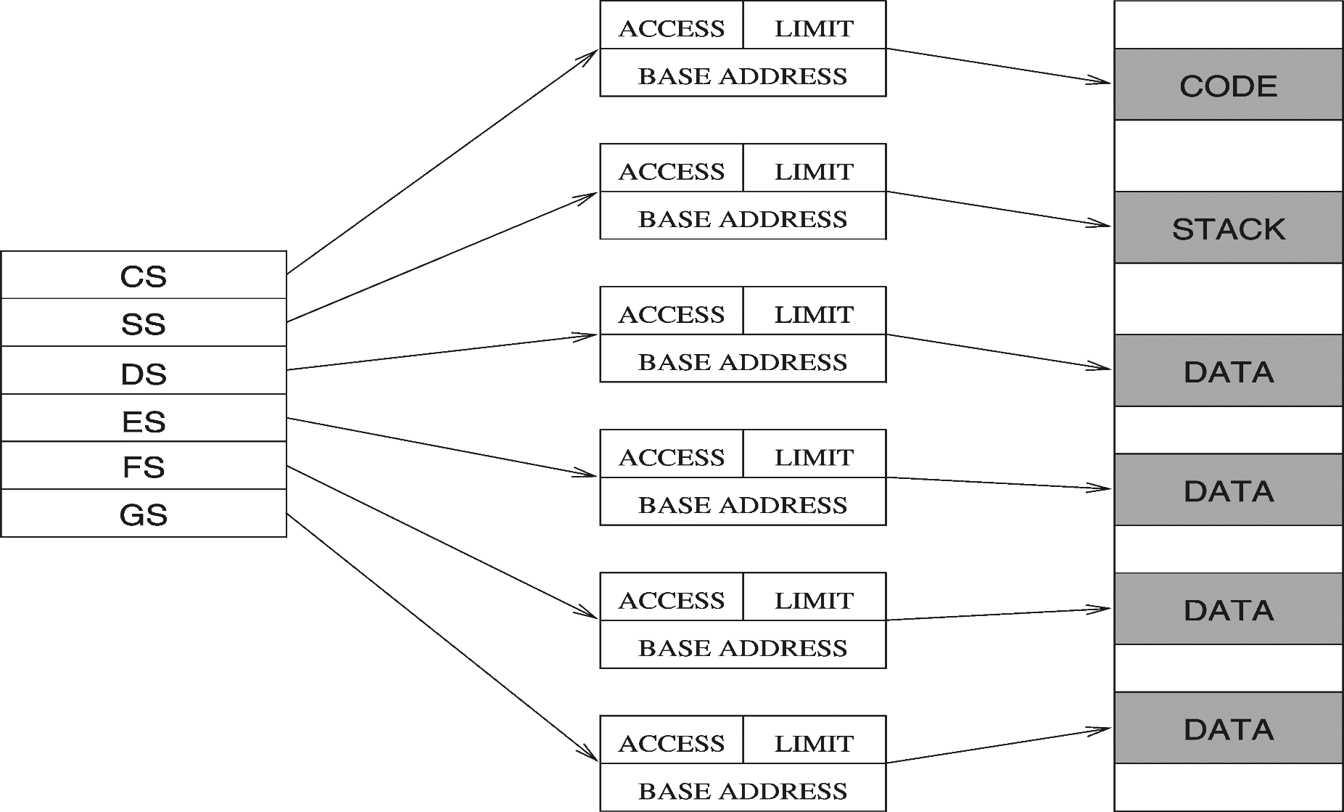
Protected Mode Architecture (cont’d)

Slide 33
Default Segments
Pentium uses default segments depending on the purpose of the memory reference
Instruction fetch
CS register
Stack operations
16-bit mode: SP
32-bit mode: ESP
Accessing data
DS register
Offset depends on the addressing mode

Slide 34
Concept of CISC and RISC
Aspect | RISC | CISC
Acronym | Reduced Instruction Set Computer | Complex Instruction Set Computer
Instruction set | Reduced | Complex
Compiler design | Easy to design | Hard to design
Hardware/Software | Stresses more on software | Stresses more on hardware
Memory management | Memory-to-memory operations | Register-to-register operations
Code size | High in code size | Less in code size
Clocking | Single clock is used | Multiple clocks are used
Instruction length | Single word instruction | Variable length instruction
Pipelining | Pipelining is the major feature | Doesn’t support pipelining

Slide 35
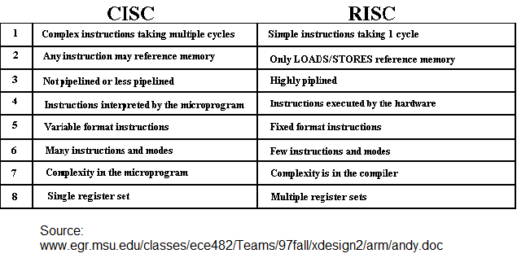

Slide 36
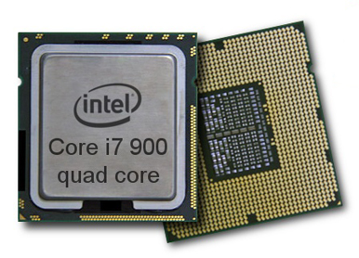
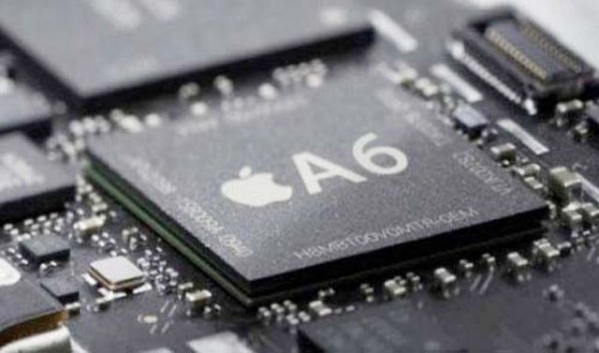
Guess….

