Slide 1
INTRODUCTION TO PIC MICROCONTROLLER

Slide 2
Overview and Features
The term PIC stands for Peripheral Interface Controller .
Microchip Technology, USA .
Basically RISC microcontrollers
5 ports
It has two types of internal memories .
One is program memory and
the other is data memory.

Slide 3
Features
Speed :
When operated at its maximum clock rate a PIC executes most of its instructions in 0.2 μs or five instructions per microsecond.
Instruction set Simplicity :
The instruction set is so simple that it consists of only just 35 instructions
Integration of operational features:
Power-on-reset (POR) and brown-out protection ensure that the chip operates only when the supply voltage is within specifications. A watch dog timer resets the PIC if the chip malfunctions or deviates from its normal operation at any time.
Programmable timer options:
Three timers can characterize inputs, control outputs and provide internal timing for the program execution.

Slide 4
Features
Interrupt control:
Up to 12 independent interrupt sources can control when the CPU deal with each sources.
Powerful output pin control:
A single instruction can select and drive a single output pin high or low in its 0.2 μs instruction execution time. The PIC can drive a load of up to 25μA.
I/O port expansion:
With the help of built in serial peripheral interface the number of I/O ports can be expanded. EPROM/DIP/ROM options are provided.

Slide 5
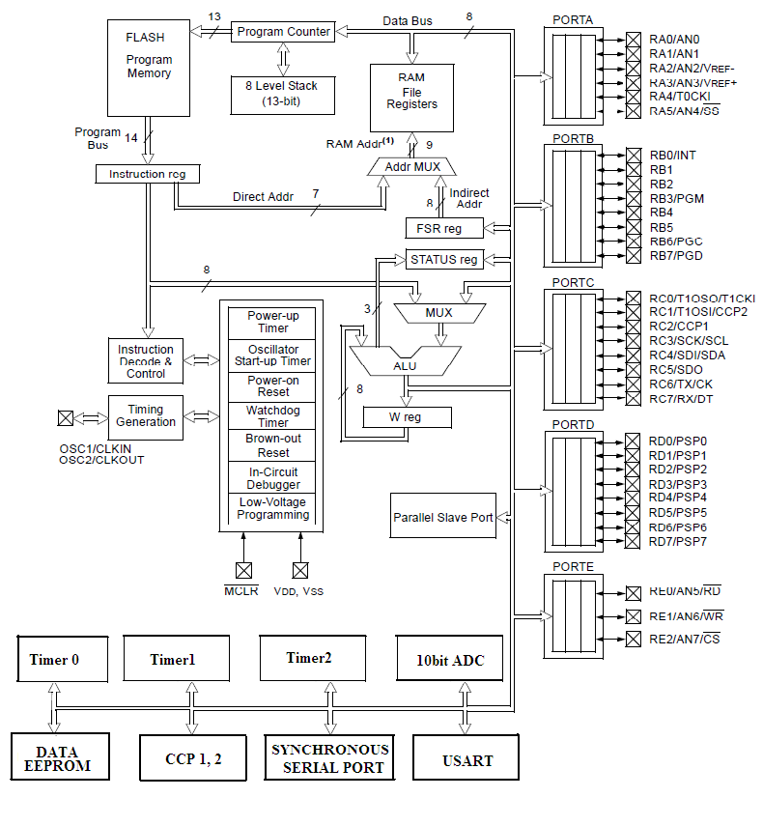
ARCHITECTURE - PIC16FXX - Harvard architecture

Slide 6
Memory organization and register file structure
The memory module of the PICcontroller has three memory blocks.
Program memory
Data memory and Stack
REGISTER FILE STRUCTURE
In PIC Microcontrollers the Register File consists of two parts namely
General Purpose Register File
Special Purpose Register File

Slide 7
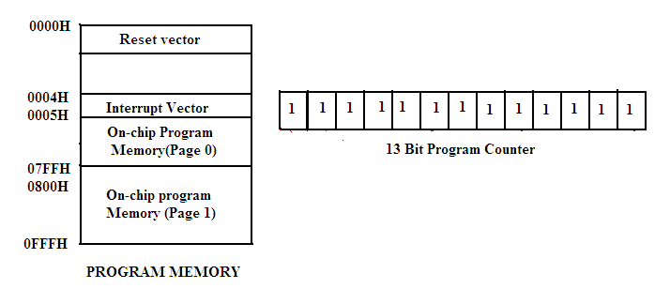
Program Memory

Slide 8
DATA MEMORY
The data memory of PIC 16F8XX is partitioned into multiple banks which contain the general purpose registers and the Special function Registers.(SFRs).
The bits RP1 and RP0 bits of the status register are used to select these banks.
Each bank extends upto 7FH(128 Bytes).
The lower bytes of the each bank are reserved for the Special Function Registers.
Above the SFRs are general purpose registers implemented as static RAM.

Slide 9
Register file structure
General Purpose Register File:
The general purpose register file is another name for the microcontroller’s RAM .
Data can be written to each 8-bit location updated and retrieved any number of times.
Special Purpose Register File:
The special function register file consists of input, output ports and control registers used to configure each 8-bit port either as input or output.
It contains registers that provide the data input and data output to a chip resources like Timers, Serial Ports and Analog to Digital converter
the registers that contains control bits for selecting the mode of operation and also enabling or disabling its operation.

Slide 10
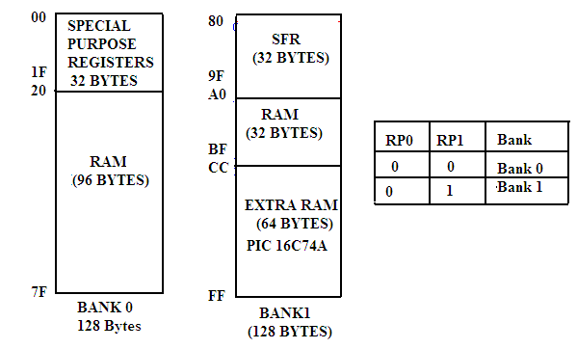
Register file structure

Slide 11
CPU REGISTERS
Microcontroller has the following registers.
Working Register-W (Similar to Accumulator)
Status Register
FSR – File Select Register (Indirect Data memory address pointer)
INDF
Program Counter

Slide 12
Status Register
DC: Digit carry/borrow bit
Z: Zero bit
NOT_PD : Reset Status bit (Power-down mode bit)
NOT_TO : Reset Status bit (tme- out bit)
RPO: Register bank Select

Slide 13
FSR – (File Select Register)
It is the pointer used for indirect addressing.
In the indirect addressing mode the 8-bit register file address is first written into FSR.
It is a special purpose register that serves as an address pointer to any address through out the entire register file.

Slide 14
INDF – (Indirect File):
It is not a physical register addressing but this INDF will cause indirect addressing.
Any instruction using the INDF register actually access the register pointed to by the FSR.

Slide 15
PROGRAM COUNTER
PIC PIC16F877A has a 13 bit program counter in which PCL is the lower 8-bits of the PC and PCLATH is the write buffer for the upper 5 bits of the PC.
PCLATH (program counter Latch can be read or from or written to without affecting the Program Counter(PC).
The upper 3 bits of PCLATH remain zero.
It is only when PCL is written to that PCLATH is automatically written into the PC at the same time.

Slide 16
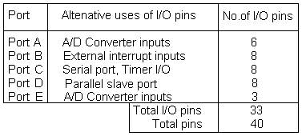
Parallel I/O Ports

